Slide 1
Exploratory Data Analysis (EDA)

Slide 2
Overview
Define exploratory data analysis (EDA)
Discuss the four EDA techniques
Univariate non-graphical
Univariate graphical
Multivariate non-graphical
Multivariate graphical
Demonstrate EDA techniques in ArcMap and R
Summary

Slide 3
Definition
Coined by John Tukey in 1977, EDA represents:
“an approach/philosophy for data analysis that employs a variety of techniques (mostly graphical) to maximize:
1. insight into a data set; 2. uncover underlying structure; 3. extract important variables; 4. detect outliers and anomalies; 5. test underlying assumptions; 6. develop parsimonious models; and 7. determine optimal factor settings (Filliben, 2004).”

Slide 4
Introduction
Four types of EDA:
Univariate Non-graphical
Ex: descriptive statistics such as mean, median, IQR, standard deviation, skewness, moran’s I, kurtosis
Univariate Graphical
Ex: histograms, qqplots
Multivariate Non-graphical
Ex: correlation and covariance matrices
Multivariate Graphical
Ex: scatterplots, boxplots

Slide 5
Descriptive Statistical Definitions
Mean – arithmetic average
Median – midpoint
Mode – most frequent value in a dataset
Standard Deviation – variation about the mean
Interquartile Range – statistical dispersion
Kurtosis – peakedness of the data distribution
Skewness – symmetry of the data distribution
Spatial Autocorrelation – correlation of a variable with itself through geographic space

Slide 6
Normality
Most statistical tests and models assume that data are normally distributed (parametric). When this assumption is violated, the results of the test or model could be inaccurate. There are two ways to handle data that are not normally distributed (nonparametric):
1. transform data so that it is normally distributed OR
2. use nonparametric tests and statistics
Notes:
The descriptive statistics like mean, standard deviation, IQR, skewness, and kurtosis describe the distribution of the data. A normal distribution has a mean of 0, standard deviation of 1, skewness of 0, and kurtosis of 0.
You can correct for normality in multiple ways: delete outliers, log-transform, square root transform,

Slide 7
When to Use Nonparametric Statistics
Parametric statistics are easier to interpret and usually have higher predictive power than nonparametric statistics (Hoskin). It is best to use nonparametric statistics when:
data cannot be transformed to have a normal distribution
there is a small sample size (n<30)

Slide 8
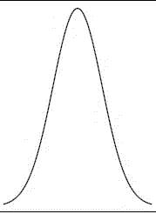
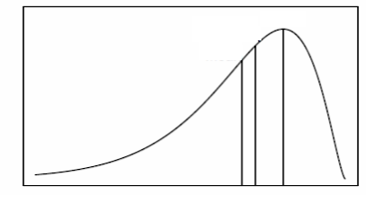
Univariate Non-graphical
Mean
Median
Mode
Mode
Mode
Mean
Median
Normal Distribution (no skew or kurtosis)
Bimodal Distribution
Mode
Mode
Mode
Median
Median
Median
Mean
Mean
Negatively skewed (skewed to the left)
Positively skewed (skewed to the right)

Slide 9
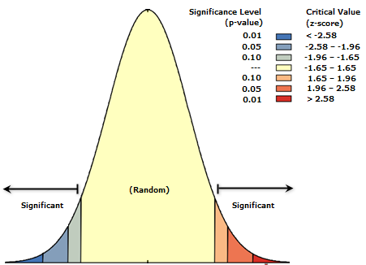
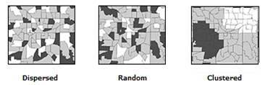
Univariate Non-graphical
High kurtosis (high peakedness)
Low kurtosis (low peakedness)
Moran’s I (spatial autocorrelation indicator)

Slide 10
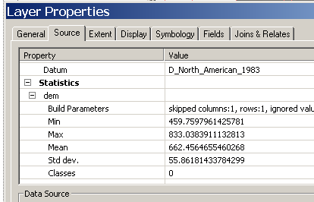

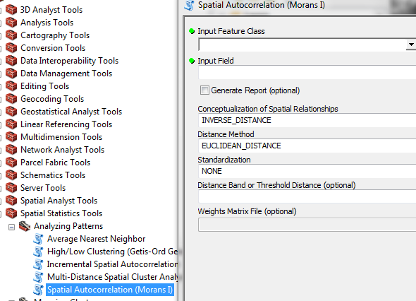
Descriptive Statistics in ArcGIS
Right-click on layer
and select Properties
Hit Source Tab and
scroll down to Statistics
Double-click Spatial Autocorrelation tool under the Spatial Statistics and Analyzing Patterns toolboxes

Slide 11
Univariate Graphical
Histogram – barplot in which each bar represents the frequency or proportion of cases for each range of values
Used in EDA to visually assess normality, skewness, kurtosis, and overall data distribution
Quantile-quantile plot (QQplot) - plot of actual data values against a Gaussian distribution (normal distribution with a mean of 0 and standard deviation of 1)
Used in EDA to visually evaluate normality and outliers

Slide 12
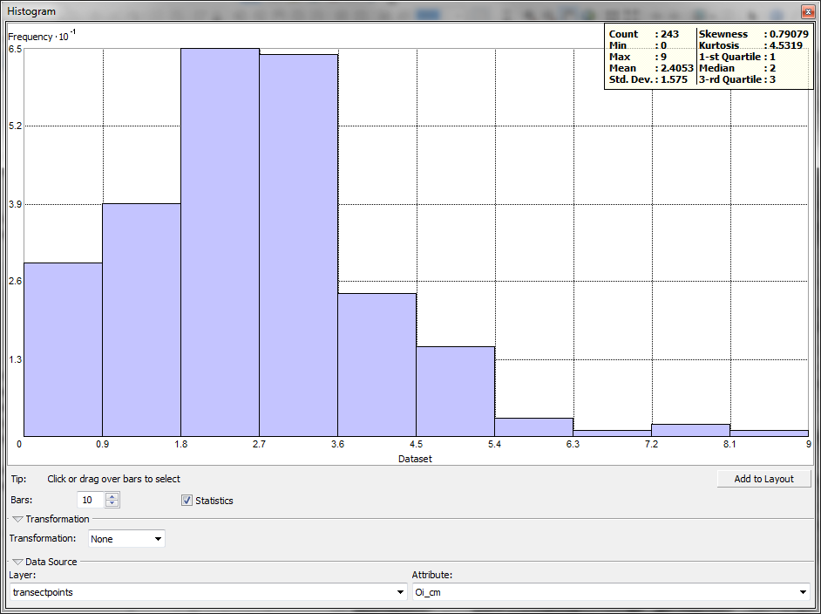
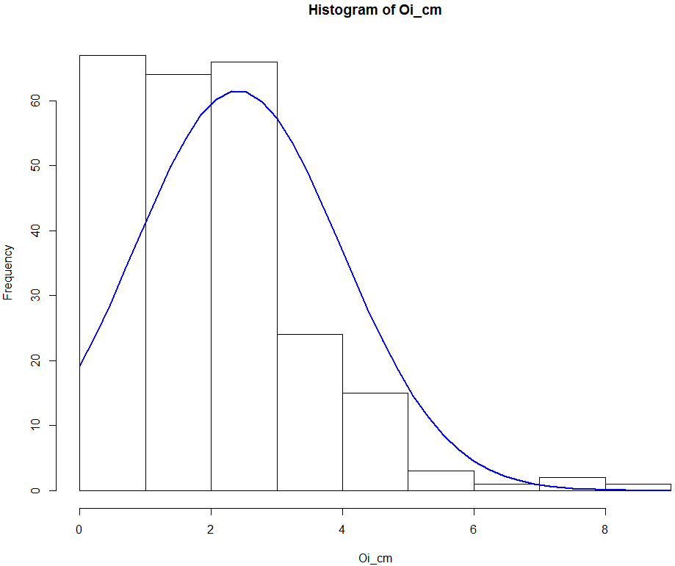
Univariate Graphical - Histograms

Slide 13
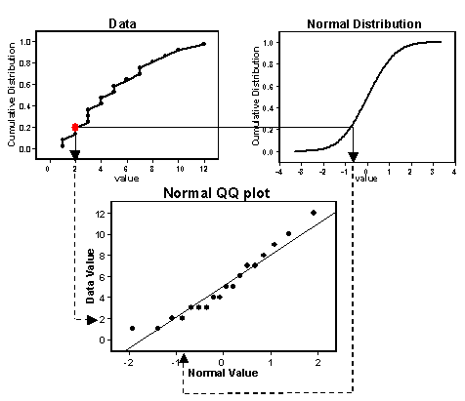
Univariate Graphical - QQPlots
ESRI
Notes:
QQ plot is a standardization of your data where 0 is the mean, 1 and 2 are 1 and 2 standard deviations.
The standard score of a raw score x ^{[1]} is
Z = x- μ/σ
where:
μ is the mean of the population;σ is the standard deviation of the population.
If data is normal, there will be a 1:1 relationship between sample data and the data from a normal curve. Sample data will be points, normal is the solid line.
If there is deviation, it is usually on the low or high end, which may be ok and close enough to normal to consider as such.
If there is deviation from the normal line around 0, data is definitely not normal.

Slide 14
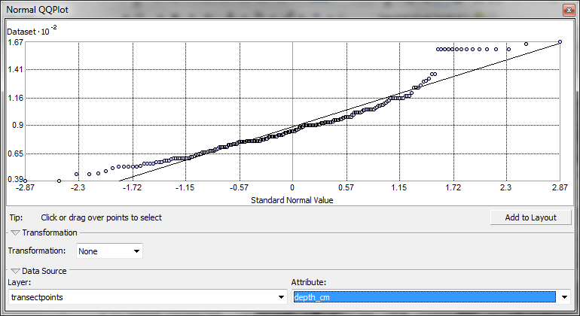
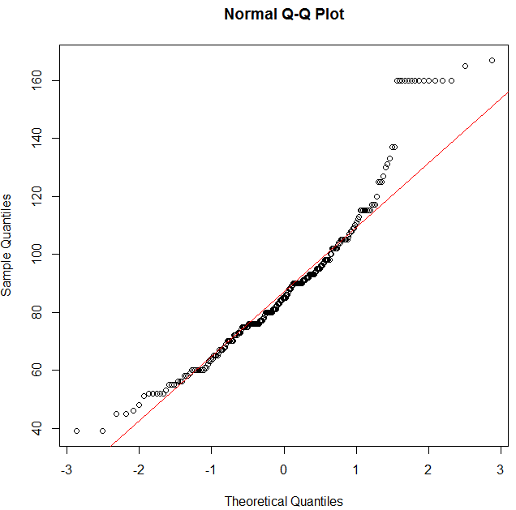
Univariate Graphical - QQPlots

Slide 15
Multivariate Non-graphical
Correlation - a quantitative measure of the relationship of two or more variables
Used in EDA to assess predictability and multicolinearity of variables
Covariance - a quantitative and graphical measure of the similarity between two variables with respect to location and mean value
Used in EDA to identify spatial autocorrelation and outliers
Stepwise Regression – forward and/or backward variable selection technique
Notes:
Multicolinearity: highly correlated variables that can contribute to over-fitting a model, lowering its predictive ability and inflating it’s validation statistics

Slide 16
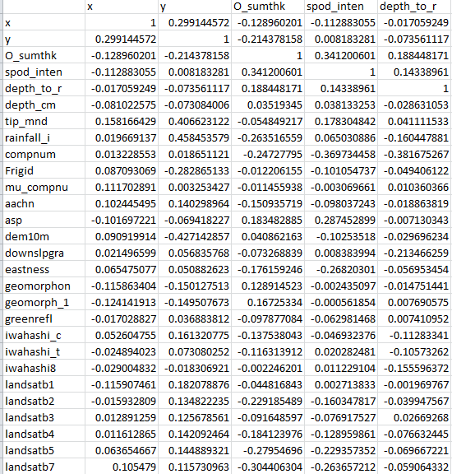
Multivariate Non-graphical Correlation
Three type of Correlation Coefficients:
Pearson’s Coefficient: parametric
Spearman’s Rho: non-parametric version of Pearson’s Correlation Coefficient
Kendall’s Tau: non-parametric; used mostly with binary and ordinal data
Notes:
Spearman’s Rho: non-parametric technique that quantifies the degree of linear association between the ranks of data
Pearson’s Coefficient: parametric technique that measures the degree of linear relationship between data
Kendall’s Tau: non-parametric measure of association based on the number of concordances and discordances in paired observations

Slide 17
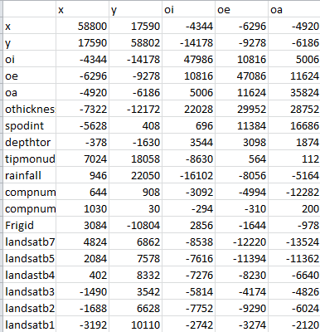
Multivariate Non-graphical Covariance
Notes:
Covariance matrix calculated in R

Slide 18
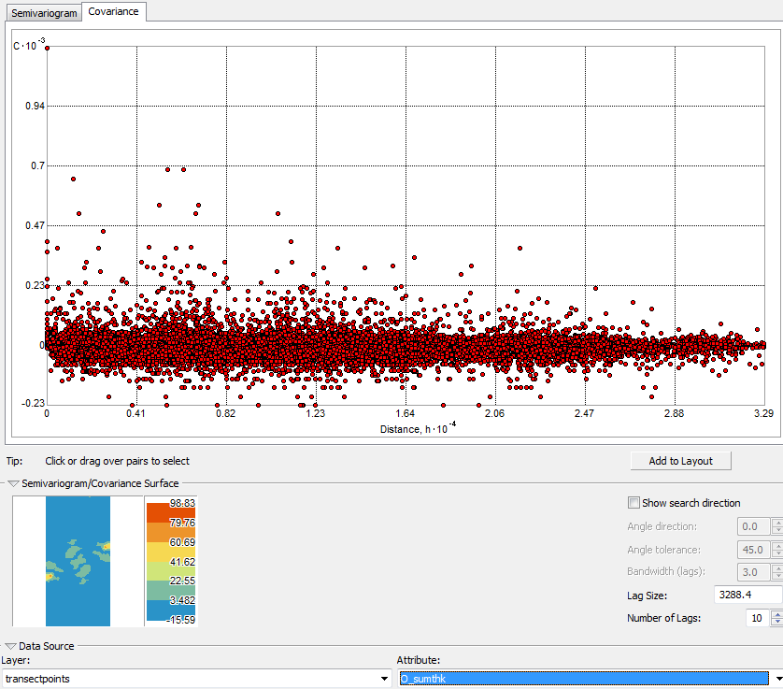
Univariate Graphical - Covariance
Notes:
In ArcMap, covariance can be displayed as univariate graphical.

Slide 19
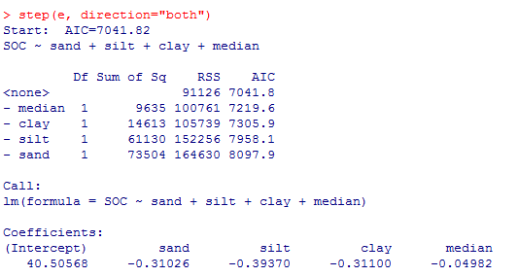
Multivariate Non-graphical Stepwise Regression

Slide 20
Multivariate Graphical
Scatterplots – graphical display of one variable plotted on the horizontal axis and another on the vertical axis
Used in EDA to visually assess relationships between variables and identify outliers
Boxplots – a visual representation of median, quartiles, symmetry, skew, and outliers
Decision Trees – a recursive statistical technique that uses dependent variables to assign discrete classes or values to an independent variable
Used in EDA for rule-based model guidance and variable importance/predictability assessment
Notes:
Boxplots rely on robust statistics like median and IQR rather than more sensitive ones like mean and standard deviation.

Slide 21
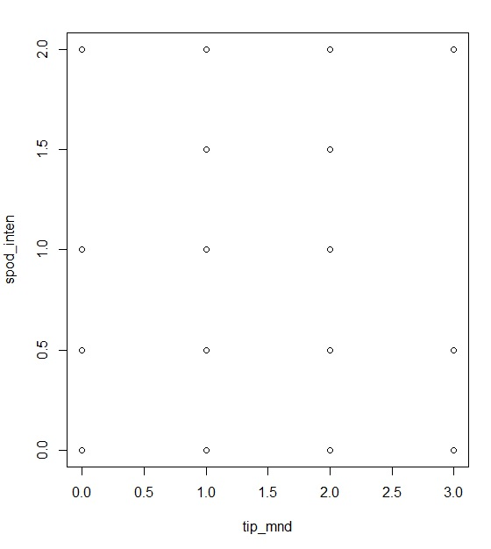
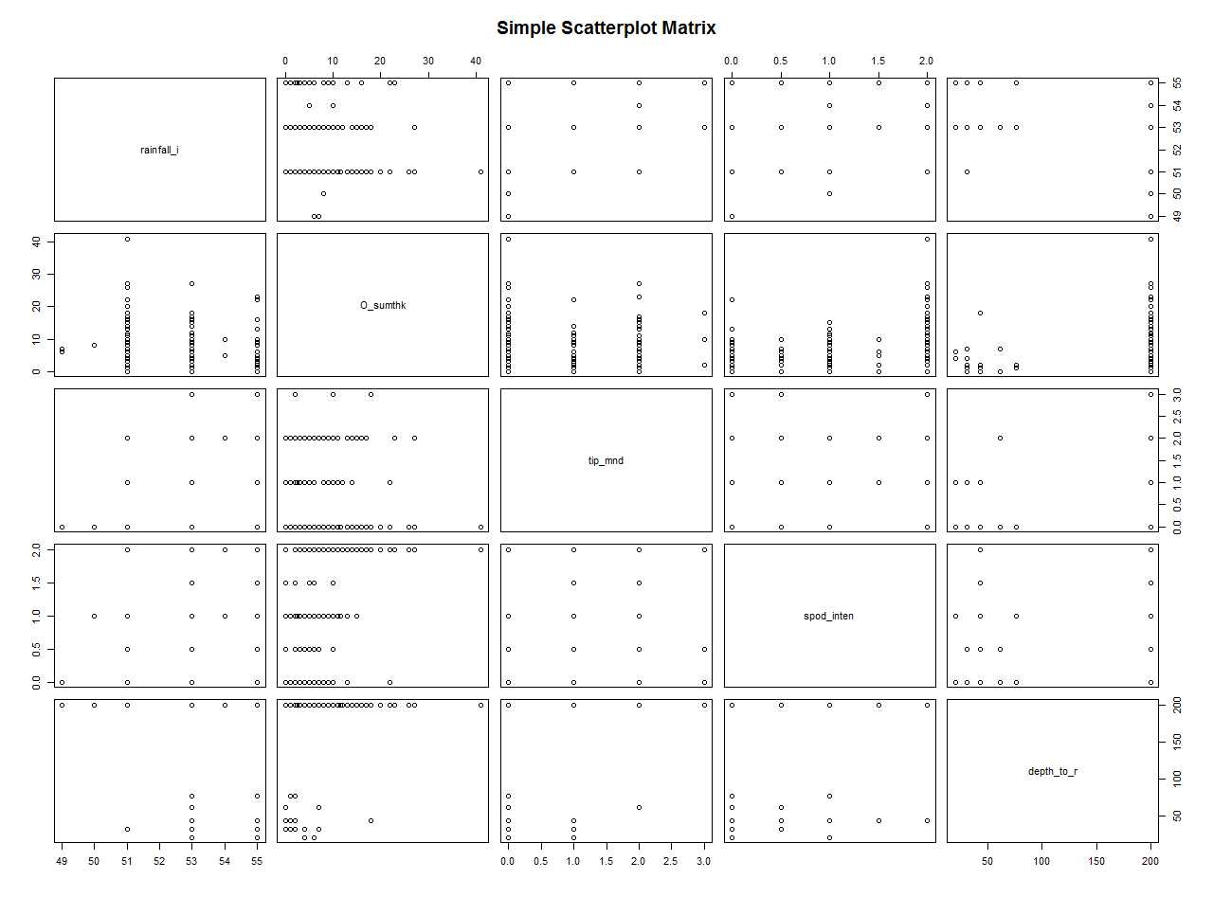
Multivariate Graphical - Scatterplots

Slide 22
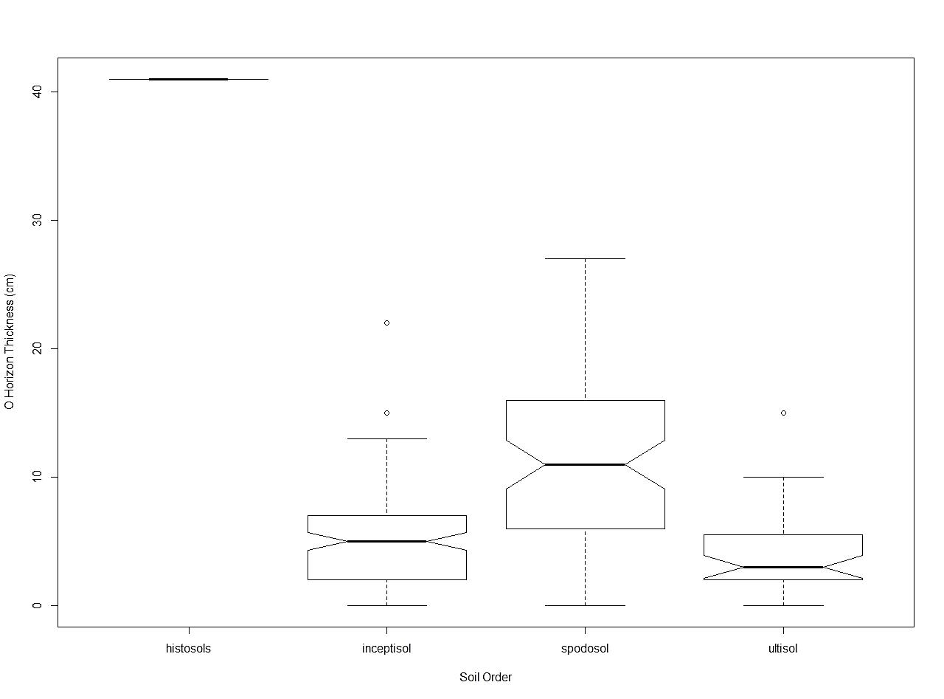
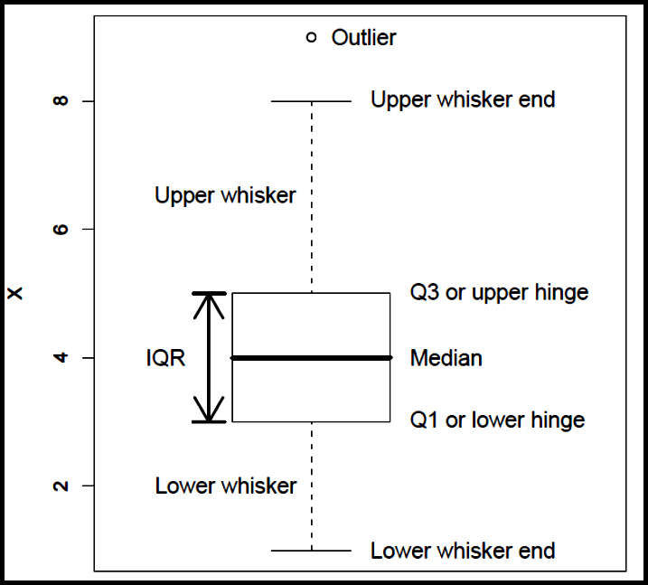
Multivariate Graphical - Boxplots
Seltman (2009)

Slide 23
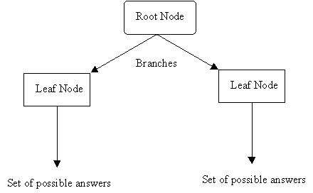
Multivariate Graphical Decision Trees

Slide 24
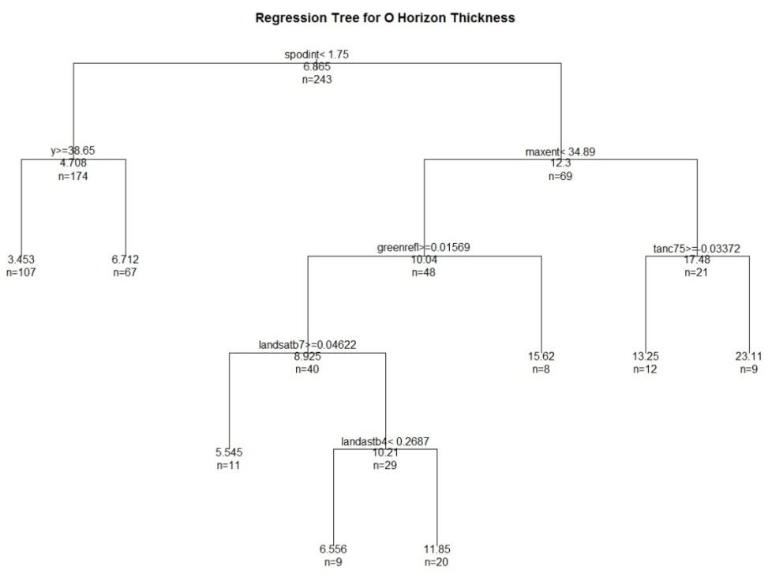
Multivariate Graphical Regression Tree

Slide 25
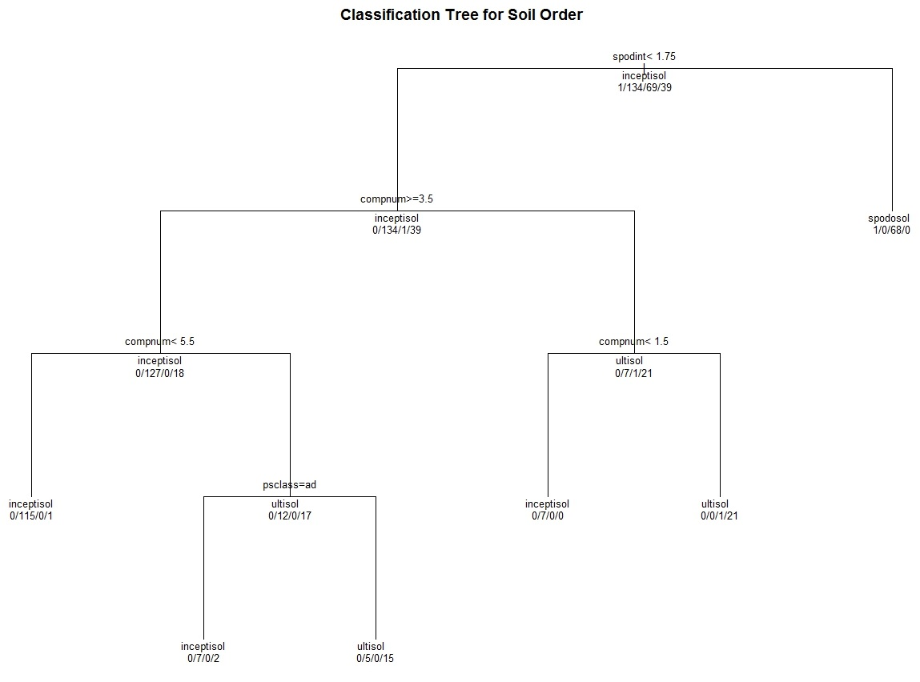
Multivariate Graphical Classification Tree

Slide 26
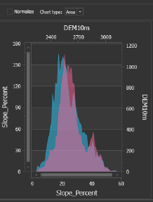
Multivariate Graphical TEUI
TEUI = Terrestrial Ecological Unit Inventory
It is an ArcGIS Add-in developed by USFS and can be used to compare data between mapunits

Slide 27
References
ESRI ArcGIS. Normal QQ plot and general QQ plot. http://help.arcgis.com/en/arcgisdesktop/10.0/help/index.html#//00310000000q000000
Filliben, J. J. 2004. NIST/SEMATECH e-Handbook of Statistical Methods. http://www.itl.nist.gov/div898/handbook/eda/section1/eda11.htm
Hoskin, T. Parametric and Nonparametric: Demystifying the Terms. Mayo Clinic. http://www.mayo.edu/mayo-edu-docs/center-for-translational-science-activities-documents/berd-5-6.pdf
King, T.S. and R. Lengerich. Statistics 509. Penn State University. https://onlinecourses.science.psu.edu/stat509/book/export/html/155
Seltman, H. 2009. Experimental Design and Analysis. Chapter 4: Exploratory Data Analysis. Carnegie Mellon University. http://www.stat.cmu.edu/~hseltman/309/Book/chapter4.pdf

Slide 28
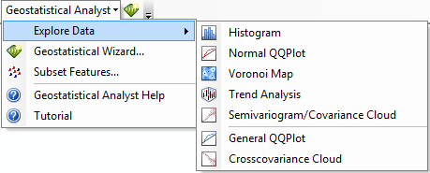
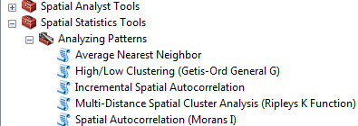
Appendix I – EDA in ArcMap
Geostatistical Analyst Toolbar (graphical assessment of normality and covariance)
Spatial Statistics Tool ArcToolbox > Analyzing Patterns (spatial autocorrelation)

Slide 29
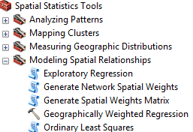

Appendix I – EDA in ArcMap
Exploratory Regression (similar to step-wise regression)
Band Collection Statistics (used to calculate Pearson correlation and covariance matrices)

Slide 30
Appendix II – Basic EDA Commands in R
Mean: mean(); Median: median(); Standard Deviation: sd(); Range: range(), Minimum: min(); Maximum: max()
Descriptive Statistics for Normality (in fBasics package): dagoTest(variable)
D’Agostino skewness, kurtosis, omnibus, and significance, see: http://help.rmetrics.org/fBasics/test-normalityTests.html for other normality tests
Histogram: hist()
QQPlot: qqnorm() and qqline()
Scatterplot: plot()
Scatterplot Matrix: scatterplotMatrix() in car package
Boxplot: boxplot()

Slide 31
Appendix II – Basic EDA Commands in R
Correlation Matrix:
cor(data, method=“kendall”)
cor(data, method=“spearman”)
cor(data, method=“pearson”)
Covariance Matrix:
cov(data, method=“kendall”)
cov(data, method=“spearman”)
cov(data, method=“pearson”)

Slide 32
Appendix II – Basic EDA Commands in R
Regression Tree (in rpart package): fit<-rpart(X~Y, method=“anova”)
Classification Tree (in rpart package): fit<-rpart(X~Y, method=“class”)

